Slide 1
A Primer on Functional Programming
Sarah Withee

Slide 2
What are you most looking forward to at Prairie.Code() ?

Slide 3
A Primer on Functional Programming
Sarah Withee

Slide 4
Monads
(jk)

Slide 5
Poll
Who has heard of functional programming?

Slide 6
Poll
Who has done functional programming?

Slide 7
Poll
Who IS a functional programmer?

Slide 8
Poll
Who has wanted to learn but never had time or good resources?

Slide 9
Intro
Functional Programming Concepts
Examples
Why Use Functional Programming?
Brief Glance at Functional Programming Languages

Slide 10
Background
It’s not new
(Languages and ideas been around since the 1950s)

Slide 11
Background
Built on ideas of lambda calculus
developed in the 1930s
(I promise, there’s no calculus today!)

Slide 12
Concepts – Pure Functions
Pure Functions:
Function that, given a certain input, always produces the same output.

Slide 13
Concepts – Pure Functions
Pure functions don’t have side effects

Slide 14
Concepts – Pure Functions
Side effects include:
Time, file access, database access, previous function calls, etc.

Slide 15
Concepts – Pure Functions
User input is never pure
Duh

Slide 16
Concepts – Pure Functions
Call by reference is never pure

Slide 17
Concepts – Pure Functions
Nearly impossible to write 100% pure function programs

Slide 18
Concepts – Pure Functions
Examples:
sin(x)
Returns the sine of angle x

Slide 19
Concepts – Pure Functions
Examples:
str.length()
Returns the length of the string str

Slide 20
Concepts – Pure Functions
Examples:
getAccountNumberFromDb(name)
… kidding… definitely not pure

Slide 21
Concepts – Pure Functions
Pure functions, when given certain input, always produce certain output
Pure functions don’t have side effects
User input is never pure
Call by reference is never pure
Nearly impossible to write 100% of a project in pure functions

Slide 22
Concepts - Referential Transparency
Referential transparency:
Any expression that can replace a function with its return value with no behavior changes

Slide 23
Concepts - Referential Transparency
Example:
If x = 3…
x + 5 = 8 3 + 5 = 8

Slide 24
Concepts - Referential Transparency
Example:
If x = 1 + 2…
x + 5 = 8 (1 + 2) + 5 = 8

Slide 25
Concepts - Referential Transparency
Pure functions always have referential transparency

Slide 26
Concepts - Referential Transparency
In mathematics, all functions are transparent
In programming, this is NOT the case

Slide 27
Concepts - Referential Transparency
Assignments are NOT transparent x = x + 1

Slide 28
Concepts - Referential Transparency
def addOne(int x): return x + 1;
If x and y are the same, then
addOne(x) and addOne(y)
give same result

Slide 29
Concepts - Lambda functions
Lambda function:
A function without a name
(Also called an anonymous function)

Slide 30
Concepts - Lambda functions
Usually for higher level functions or to pass arguments to one
Usually used once to a few times

Slide 31
Concepts - Lambda functions
Can’t be recursive*
* otherwise they need a name or some way of maintaining state**
** which is possible but outside of this scope

Slide 32
Concepts - Lambda functions
Example:
f = lambda x: x*x
print f(5)
lambda argument
Function definition
variable

Slide 33
Concepts - Lambda functions
Functions ARE values
Functions can be passed as values into functions

Slide 34
(Warning: mind blowing example ahead)

Slide 35
Concepts - Lambda functions
def divide(x, y): return x/y
def divisor(d): return lambda r: divide (r, d)
half = divisor(2)
print half(32)
lambda r: divide(r, 2)
divide(32, 2)

Slide 36
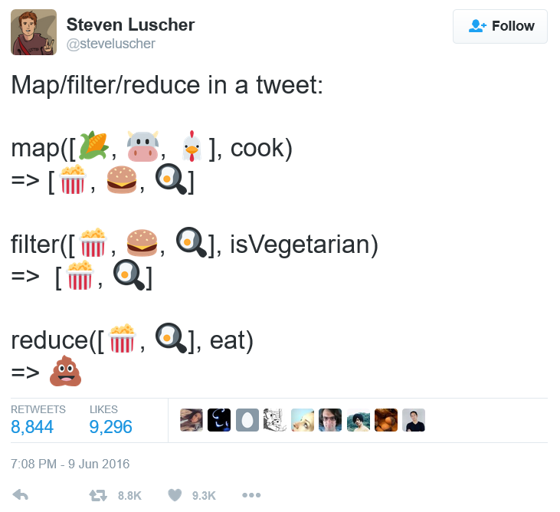
Concepts – Map/Filter/Reduce

Slide 37
Concepts – Map/Filter/Reduce
Map
Applies function across all elements in set

Slide 38
Concepts – Map/Filter/Reduce
map(data, function)
Ex: map (people, registerToVote())

Slide 39
Concepts – Map/Filter/Reduce
Filter
Reduce data in set by using function to filter

Slide 40
Concepts – Map/Filter/Reduce
filter(data, function)
Ex: filter (people, ageAtLeast18())

Slide 41
Concepts – Map/Filter/Reduce
Reduce
Combine data using function to process it

Slide 42
Concepts – Map/Filter/Reduce
reduce(data, function)
Ex: reduce (people, calculateVotes())

Slide 44
Concepts – Map/Filter/Reduce

Slide 45
Concepts - Extra
Monads
Closures
Functors
Outside of the scope of today

Slide 46
Why Use Functional Languages?
Pure functions are simpler and faster to write

Slide 47
Why Use Functional Languages?
Pure functions that work correctly will always work correctly

Slide 48
Why Use Functional Languages?
Stack traces are a pain in OOP
Stack traces in FP simplify things

Slide 49
Why Use Functional Languages?
No side effects makes unit tests pass reliably

Slide 50
Why Use Functional Languages?
Global state of program isn’t affected by pure functions

Slide 51
Why Use Functional Languages?
Concurrency is WAY easier

Slide 52
Why Use Functional Languages?
Code ends up better as functions are designed better
Better small modules -> better large modules

Slide 53
Why Use Functional Languages?
Pure functions are simpler and faster to write
Pure functions that work correctly will always work correctly
Stack traces in FP simplify things
No side effects makes unit tests pass reliably
Global state of program isn’t affected by pure functions
Concurrency is WAY easier
Functions are designed better
Better small modules -> better large modules

Slide 54
Activity 1
In a moment, everyone will stand up.
Start at the beginning of the room with 0
Each person will take the previous number, add 1 to it
Say the number out loud
Sit down
Last person reports the total

Slide 55
Activity 2
In a moment, everyone will stand up.
You are 1 person, so number is 1
Find a neighbor
Total your two numbers together
One of you sits down
Repeat steps 2-4 for each person in the row
Extra volunteer will count the array of results (end of each row), add them up
Volunteer will return the final result

Slide 56
Example of Functional Thinking
Activity 1 resembles a for or while loop
x = x + 1 type thought
Took a long time
n steps

Slide 57
Example of Functional Thinking
Activity 2 resembles concurrent recursive function
def countPerson (theirNum): return theirNum + 1 def rows (arrayValues): return sum(arrayValues) + 1
Multi-threaded
Much faster and fewer steps

Slide 58
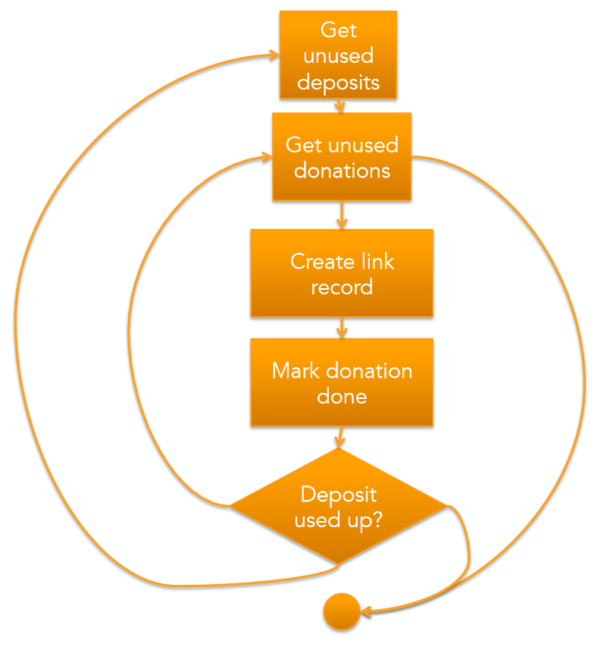
Curtesy of Jessica Kerr (@jessitron)

Slide 59
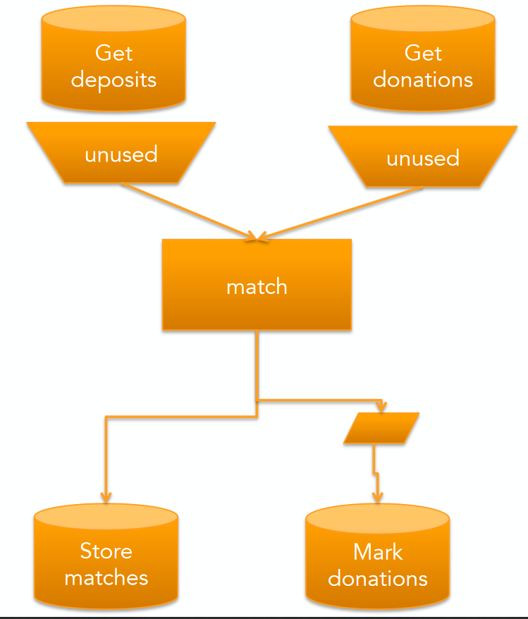
Curtesy of Jessica Kerr (@jessitron)

Slide 60
List of Functional Languages (Pure)
Agda
Charity
Clean
Coq
Curry
Elm
Frege
Haskell
Hope
Joy
Mercury
Miranda
Idris
SequenceL

Slide 61
List of Functional Languages (Not Pure)
APL
ATS
CAL
C++ (since C++11)
C#
Ceylon
D
Dart
ECMAScript
ActionScript
ECMAScript for XML
JavaScript
Jscript
Erlang
Elixir
LFE
F#
FPr
Groovy
Hop
J
Java (since Java 8)
Julia
Lisp
Clojure
Common Lisp
Dylan
Emacs Lisp
LFE
Little b
Logo
Scheme
Racket
Tea
Mathematica
ML
Standard ML
Alice
Ocaml
Nemerle
Opal
OPS5
Poplog
Python
Q
R
Ruby
REFAL
Rust
Scala
Spreadsheets

Slide 62
Languages - Elm
Pure functional language
Statically typed (primitive types, lists, tuples, records, unions)
Immutable types (keeps data pure by making you create new variables)
No runtime exceptions (compiler finds them first)
Super friendly error messages
Compiles to JavaScript for the browser

Slide 63
Languages - Haskell
Pure functional language
Statically typed, type inference
Lazy evaluation and pattern matching

Slide 64
Languages - LISP
“LISt Processor”
(Known as the language with all the parentheses)
NOT a pure functional language
Dynamically typed (mostly lists of any type)
Solve on first item in list, recursively solve on rest of list

Slide 65
Languages - Clojure
Dialect of LISP
Dynamically typed
Runs on Java Virtual Machine (JVM)
Used by Amazon, Capital One, Cerner, Groupon, Spotify, many others

Slide 66
Languages – F#
Functional and Object Oriented (compiles into .Net)
Based on Ocaml and C#
Strongly typed, but inferred
Every statement returns a type
Parallelism is easily built into language
Great for data analysis

Slide 67
Languages – Scala
Runs on JVM, can use Java libraries/code
Object-oriented (like Java) but functional too
Statically typed
Lazy evaluation
Immutable types

Slide 68
Conclusion
Functional programming is getting popular, but been around for decades
Functional principles makes your code simpler, smaller, and more reliable
Functional concepts can work in nearly any language
There’s many functional languages so you can find one that’s similar to your favorite language

Slide 69
Thank You!
Sarah Withee
@geekygirlsarah
sarah@sarahwithee.com
I’d love to hear how you’re using your new knowledge!

